Slide 1

BRITISH AIRWAYS
Customer Rating Analysis And Insights

Slide 2
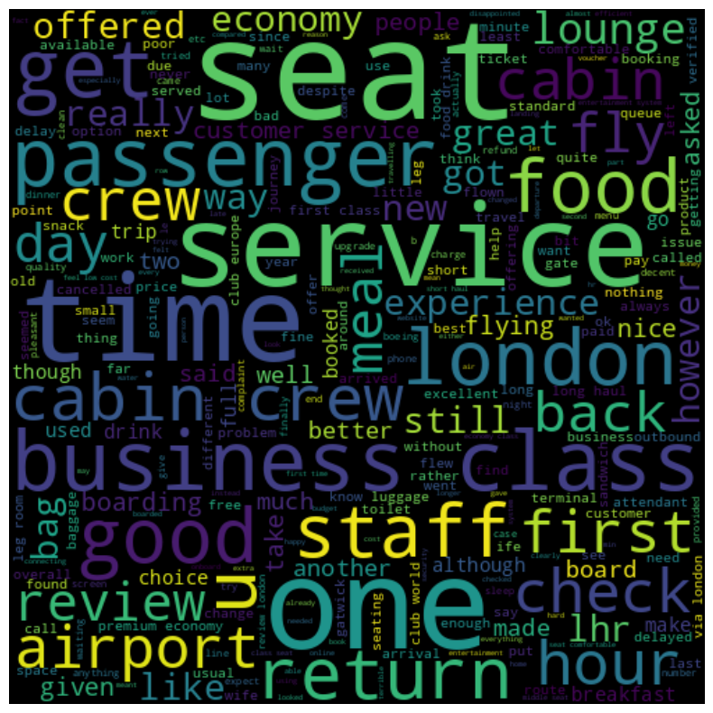
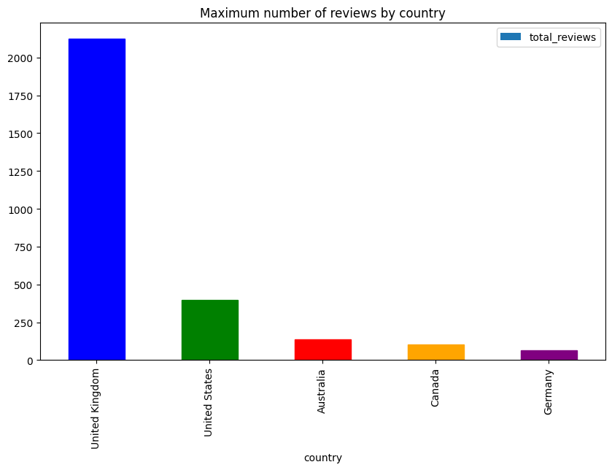
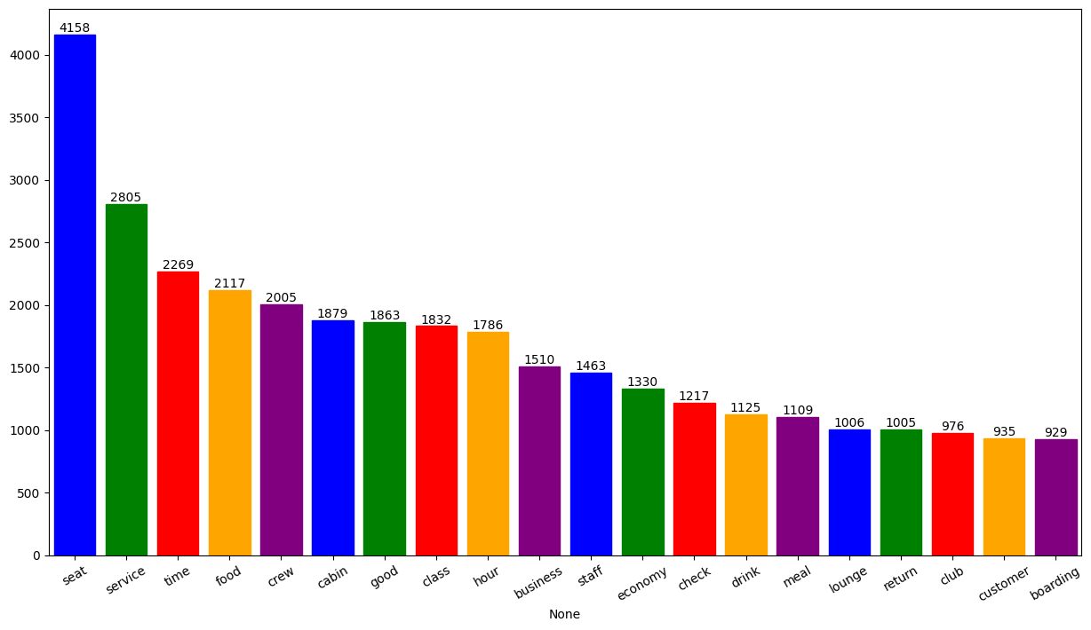
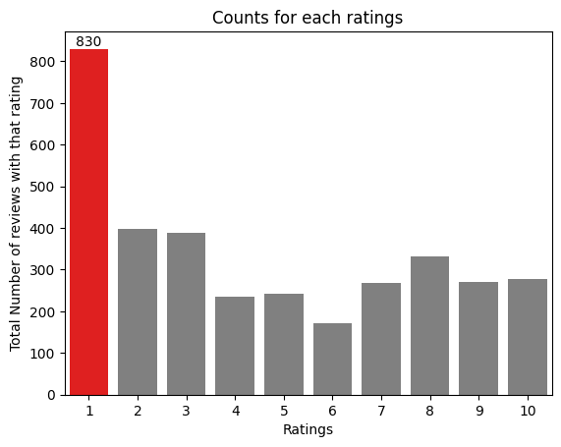
Key Metrics
What customers are happy and unsatisfied about for different rating classes:
7-10 ratings wrote about comfortable seats, good inflight entertainment, and decent food quality.
4-6 ratings faced problems with a small entertainment screen, long passport check queue, and bad business class experience.
1-3 ratings wrote dissatisfaction with the congested middle seat and small screen while they liked the seats and the food and were unsatisfied.
Average Overall Rating: 4.603 /10
Reviews from 70 countries
3413 Total Reviews Collected
All Customers liked the Cabin crew service and staff, and general economy seats. Many travelled in Business class.
Focus on - Economy class service, seats, enhanced inflight entertainment experience, and importantly Delays. Enhance the experience of business class, it seems customers want value for money. Improve Customer service on refund requests and processes.

